Slide 1
Database Essentials
Microsoft Access 2013
Lesson 1

Slide 2
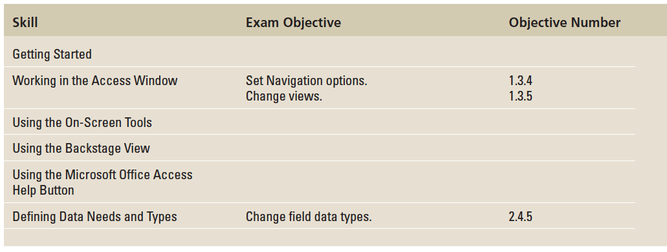
Objectives

Slide 3
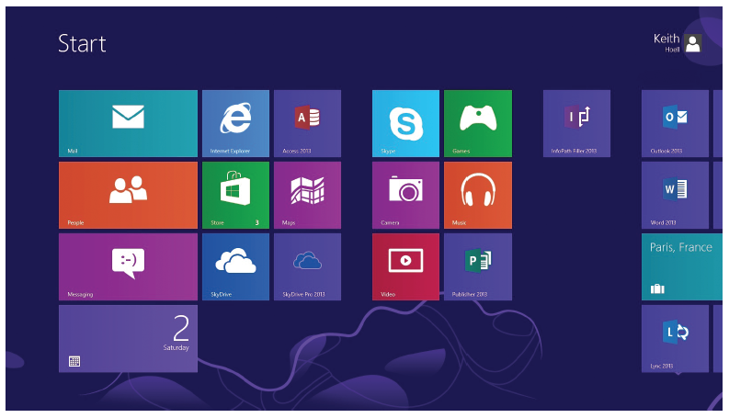
Step by Step: Start Access in Windows 8
GET READY. Before you begin these steps, be sure to turn on and/or log on to your computer.
When starting Windows 8, if the Windows 8 Start screen doesn’t appear, press the Windows key on the keyboard to display it. Your screen should look similar to the figure above.

Slide 4

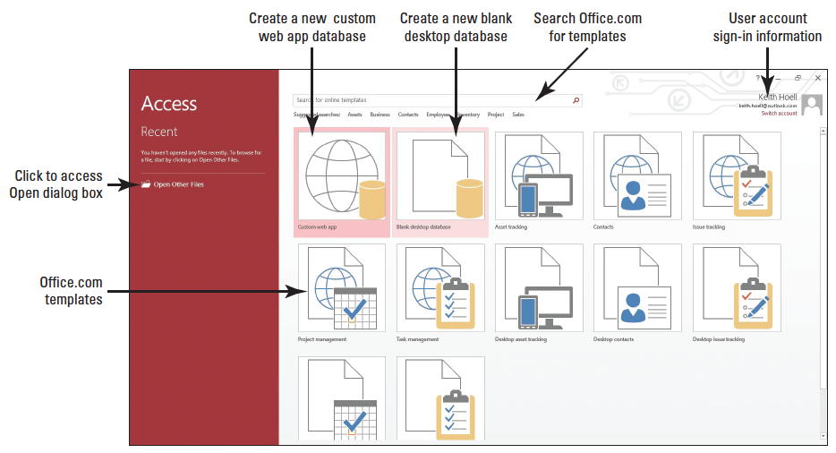
Step by Step: Start Access in Windows 8
If necessary, scroll to the Access 2013 tile, as shown at right.
Click the Access 2013 tile. The Access startup screen opens, as shown below.
PAUSE. LEAVE Microsoft Access open to use in the next exercise.
Notes:
Take Note: The Microsoft Office 2013 System, including Access 2013, is not compatible with Windows XP and earlier Microsoft Windows operating systems.

Slide 5

Step by Step: Step by Step: Start Access in Windows 7
GET READY. Before you begin these steps, be sure to turn on and/or log on to your computer.
When starting Windows 7, on the Windows taskbar, click the Start button and then click All Programs. A menu of installed programs appears.
Click Microsoft Office. Another menu appears.
Click Microsoft Access 2013. The Access startup screen opens, as shown at right.
PAUSE. LEAVE Microsoft Access open to use in the next exercise.

Slide 6
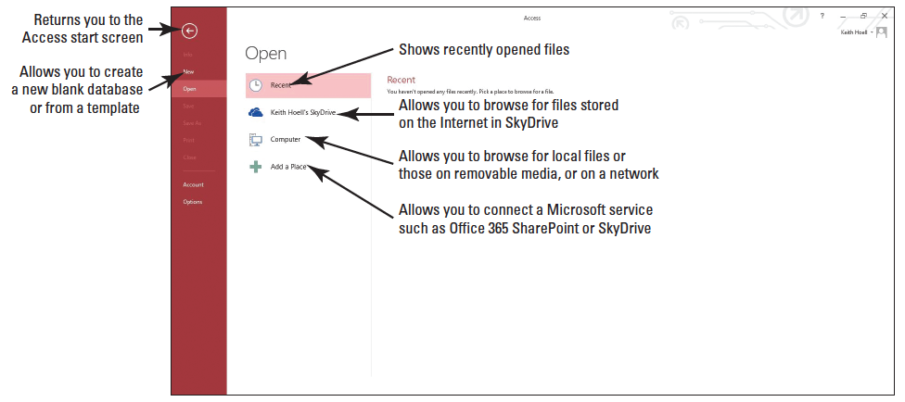
Step by Step: Open an Existing Database
GET READY. The Access startup screen should be on the screen from the previous exercise.
Click the Open Other Files command on the left side of the start screen. The Open screen appears, as shown below.
Navigate to the data files for this lesson and select Student Information. The Open dialog box appears.

Slide 7
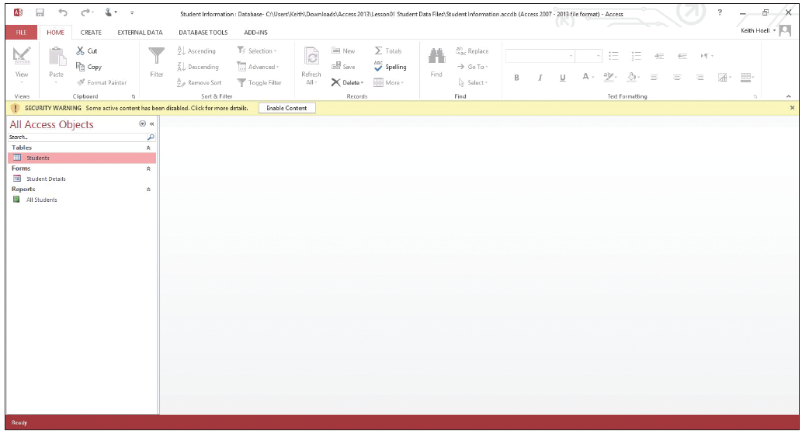
Step by Step: Open an Existing Database
In the Open dialog box, click the Open button. The existing database opens, as shownbelow.
PAUSE. LEAVE the database open to use in the next exercise.
Notes:
Take Note: Your figures might look slightly different depending upon which folder you have stored your files.
Troubleshooting: As part of the Office Access 2013 security model, when you open a database outside of a trusted location or the database contains active content (content that can be misused by an unscrupulous person to cause harm to your computer), a Message Bar tool appears, warning you that certain content has been disabled. If you know you can trust the database, click Enable Content.
Take Note: Since you know you can trust the databases downloaded from the book companion website, click Enable Content on the Message Bar for all databases in this book.

Slide 8
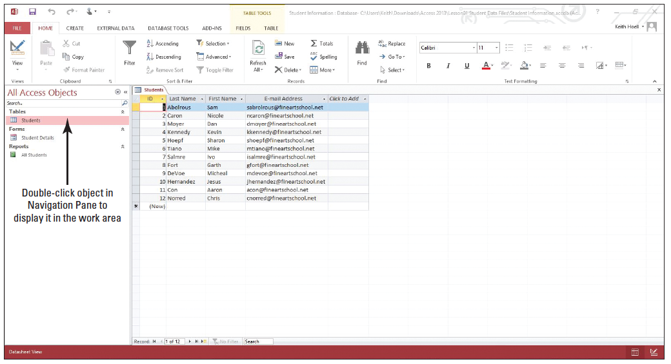
Step by Step: Use the Navigation Pane
USE the database from the previous exercise.
In the Navigation Pane, double-click Students to display the table in the Access work area, as shown below.
Notes:
Take Note: The Navigation Pane replaces an older tool, referred to as the Database window, which appeared in versions prior to Access 2007.

Slide 9
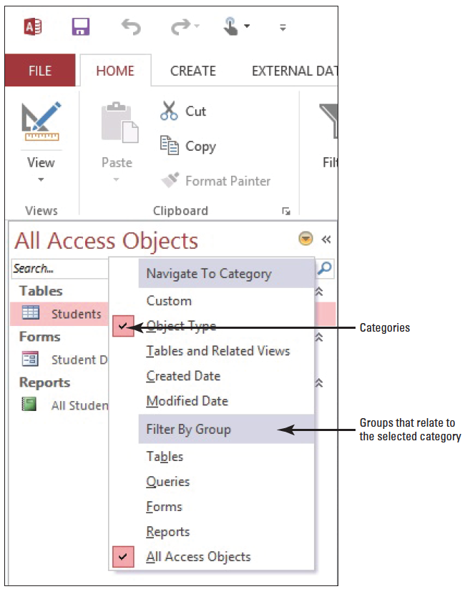
Step by Step: Use the Navigation Pane
Click the down arrow next to All Access Objects at the top of the Navigation Pane to display the menu, as shown at right.
Click Tables and Related Views. The default group in this category is All Tables, which appears in the menu at the top of the Navigation Pane. Notice the Students table and all other objects related to it are displayed under the Students header.

Slide 10
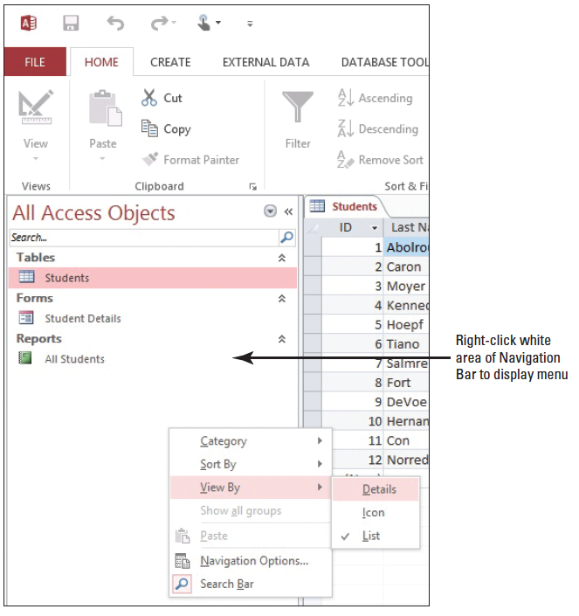
Step by Step: Use the Navigation Pane
Click the down arrow next to All Tables at the top of the Navigation Pane to display the menu again, and click Object Type to return to the original view.
Right-click in the white area of the Navigation Pane to display a shortcut menu. Click View By and then choose Details, as shown at right.

Slide 11
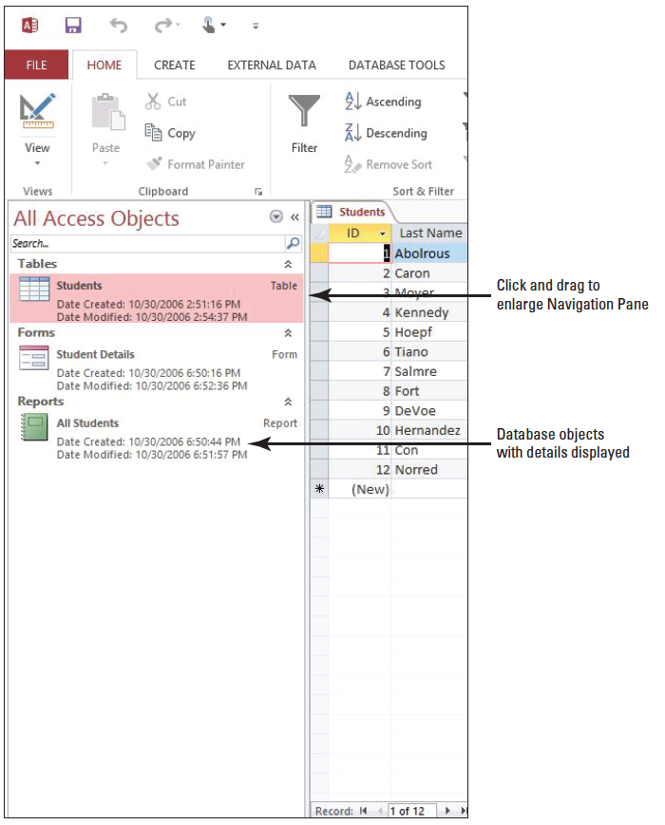
Step by Step: Use the Navigation Pane
The database objects are displayed with details. Click the right side of the Navi- gation Pane and drag to make it wider so all the information can be read, as shown at right.

Slide 12
Step by Step: Use the Navigation Pane
If the search bar does not appear at the top of the Navigation Pane, right-click the All Access Objects header of the Navigation Pane. On the shortcut menu, click Search Bar. A search bar is now displayed at the top of the Navigation Pane. You can toggle the search bar display by clicking the Search Bar option.
Display the Navigation Pane shortcut menu, click View By, and then List to display the database objects in a list.

Slide 13
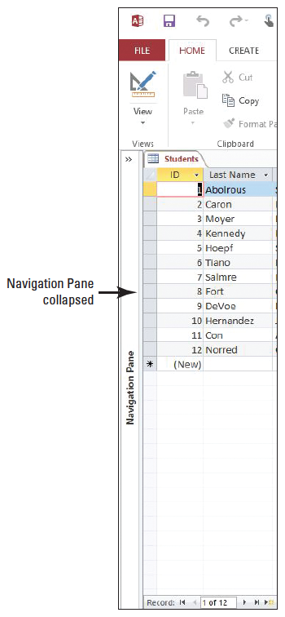
Step by Step: Use the Navigation Pane
Click the Shutter Bar Open/Close Button to collapse the Navigation Pane. Notice it is not entirely hidden, as shown at right.
Click the Shutter Bar Open/Close Button to expand the Navigation Pane again.
PAUSE. LEAVE the database open to use in the next exercise.

Slide 14
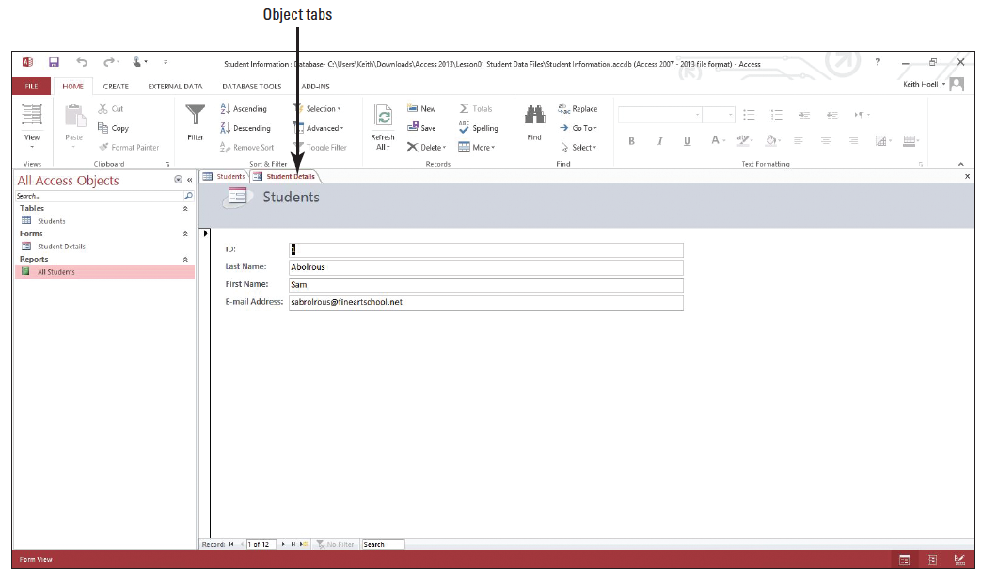
Step by Step: Use Object Tabs
USE the database you used in the previous exercise.
In the Navigation Pane, double-click Student Details. A new object tab opens to display the form, as shown below.

Slide 15
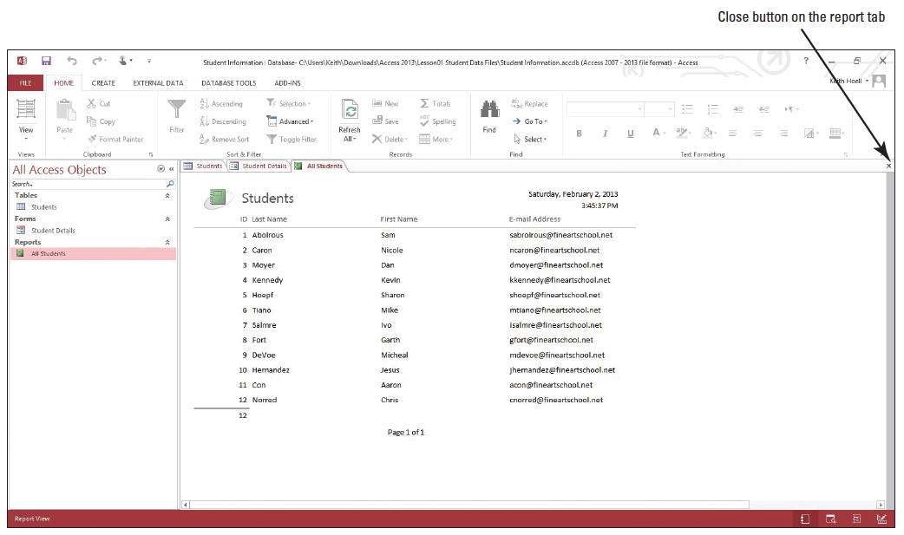
Step by Step: Use Object Tabs
In the Navigation Pane, double-click All Students. A new object tab opens to display the report, as shown below.
Click the Close button on the Report tab to close it.

Slide 16
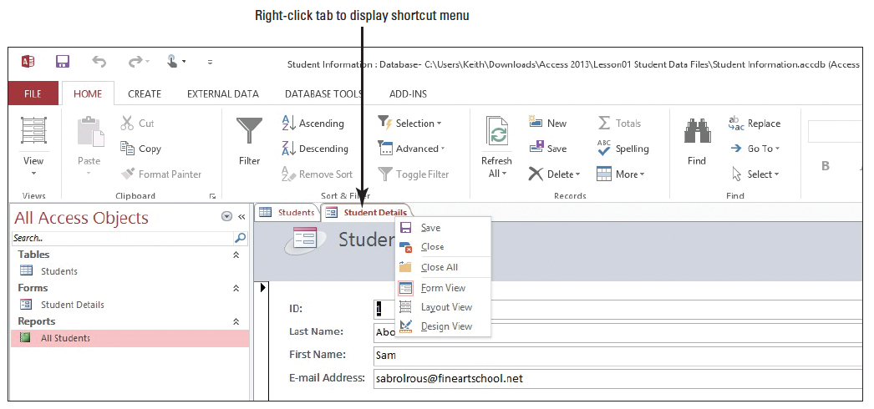
Step by Step: Use Object Tabs
Right-click the Student Details tab to display the shortcut menu shown below.
Click Close to close the form.
PAUSE. LEAVE the database open to use in the next exercise.

Slide 17
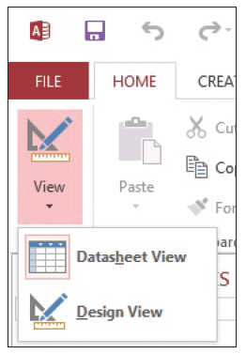
Step by Step: Change Views
USE the database you used in the previous exercise. The Students table should be displayed in the Access work area.
On the HOME tab, in the Views group, click the down arrow on the View button to display the menu shown at r ight.

Slide 18
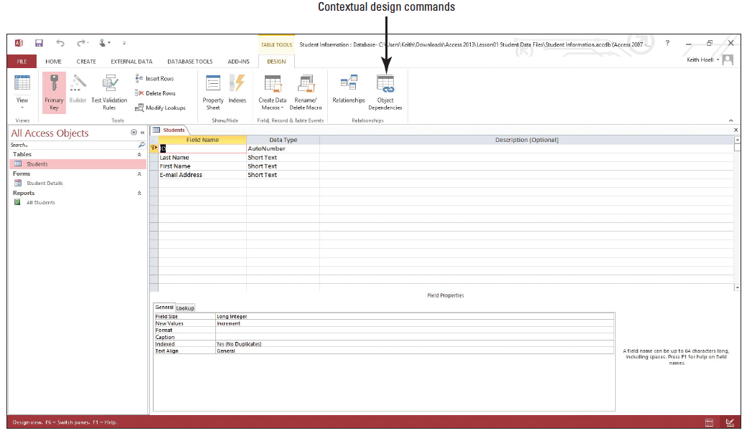
Step by Step: Change Views
Click Design View. The table is displayed in Design View, as shown below. Notice that the Design tab is now displayed.
On the Design tab, in the Views group, click down arrow on the View button, and then click Datasheet View.

Slide 19
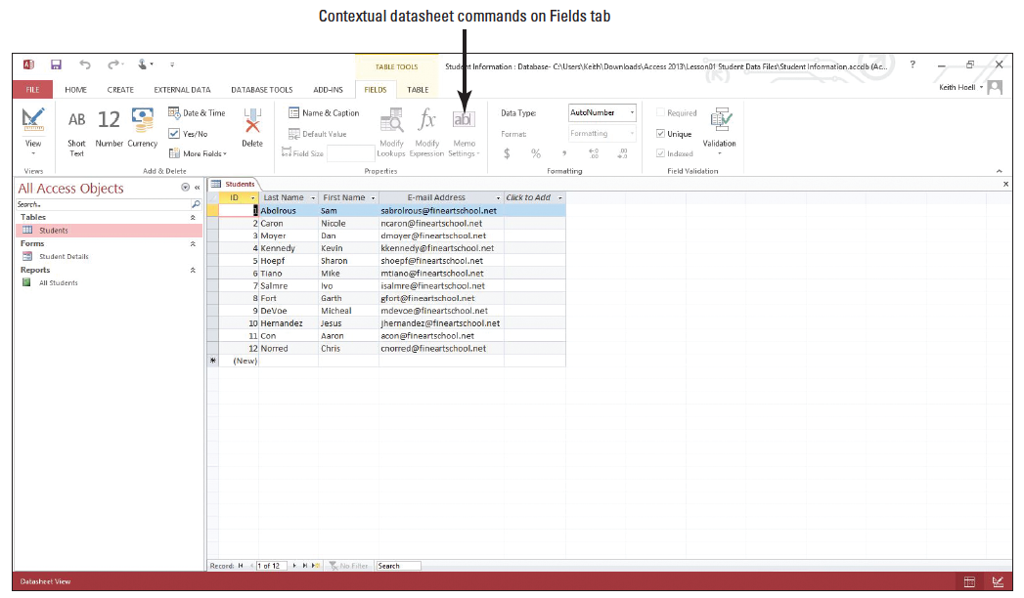
Step by Step: Change Views
On the Ribbon, under the TABLE TOOLS s tab, click the Fields tab to display the contextual commands for that view, as shown below.
PAUSE. LEAVE the database open to use in the next exercise.

Slide 20
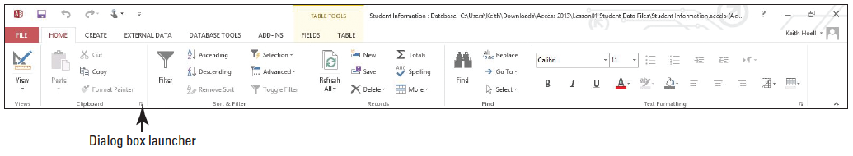
Step by Step: Use the Ribbon
USE the database you used in the previous exercise.
Click the HOME tab to make it active. As shown ibelow, the Ribbon is divided into groups of commands. Notice the dialog box launcher in the lower-right corner of the Clipboard group.
Click the CREATE tab to make it the active tab. Notice that the groups of commands change.
Click External Data and then Database Tools to see the commands available on those tabs.

Slide 21
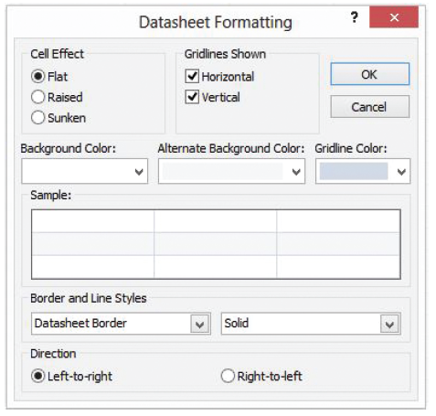
Step by Step: Use the Ribbon
Click the HOME tab.
Click the ID column header in the table to select it.
Click the dialog box launcher in the lower-right corner of the Text Formatting group. The Datasheet Formatting dialog box appears, as shown at right.

Slide 22
Step by Step: Use the Ribbon
Click Cancel to close the dialog box.
Double-click the HOME tab. Notice the groups are hidden to give you more screen space to work with your database.
Double-click HOME again to display the groups.
PAUSE. LEAVE the database open to use in the next exercise.
Notes:
Take Note: You can customize the Ribbon to have greater control over the commands that appear on it by turning off tabs and groups you rarely use, moving and/or duplicating groups from one tab to another, creating custom groups, and even creating custom tabs.

Slide 23
Step by Step: Use the Quick Access Toolbar Menu
USE the database you used in the previous exercise.
On the Quick Access Toolbar, click the Customize Quick Access Toolbar button. A menu appears.
Click Show Below the Ribbon. The toolbar is moved.
Click the Customize Quick Access Toolbar button again. Click Show Above the Ribbon.
PAUSE. LEAVE the database open to use in the next exercise.

Slide 24
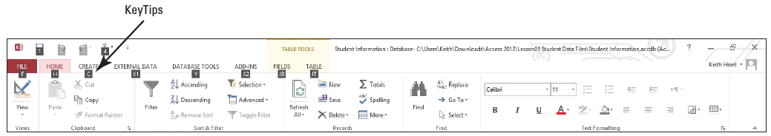
Step by Step: Use KeyTips
USE the database you used in the previous exercise.
Press ALT. Letters and numbers appear on the Ribbon to let you know which key to use to access commands or tabs. See below.
Press C to activate the CREATE tab.
Press P to display the Application Parts menu.
Press ALT to remove the KeyTips.
PAUSE. LEAVE the database open to use in the next exercise.
Notes:
Cross-Reference: You learn more about Application Parts in Lessons 2 and 10.
Take Note: Shortcut keys are keys or combinations of keys pressed together to perform a command. Shortcut keys provide a quick way to execute commands without having to move your hands off the keyboard and reach for a mouse. Keyboard shortcuts from previous versions of Access that begin with CTRL are the same. However, those that begin with ALT are different and require the use of KeyTips.

Slide 25
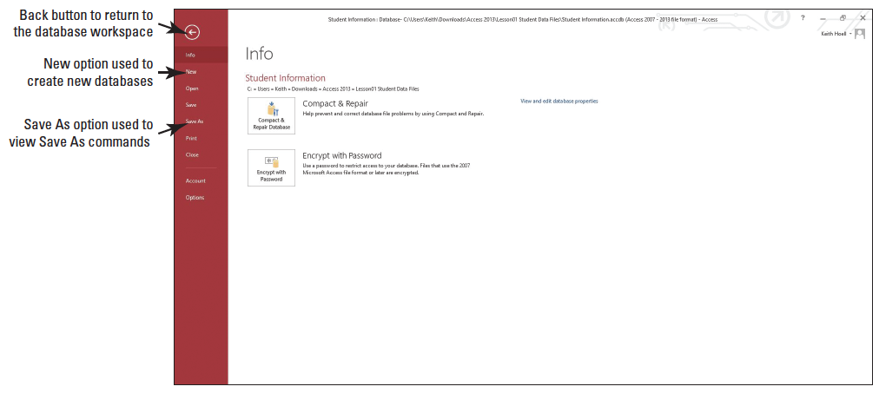
Step by Step: Use the Backstage View
USE the database you used in the previous exercise.
Click the FILE tab. Backstage view opens, displaying a menu of options down the left side of the window and information about the currently opened database, as shown below.

Slide 26
Step by Step: Use the Backstage View
Click the New option to view the options and commands available.
Click the Save As option to view more options and commands.
Click the Back button to remove the menu and return to the Access workspace.
PAUSE. LEAVE the database open to use in the next exercise.

Slide 27
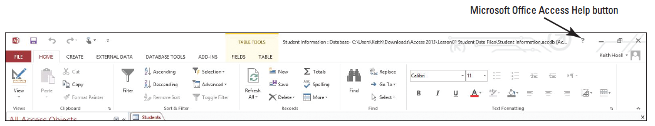
Step by Step: Use the Help Button and Change Help Location Menu
USE the database you used in the previous exercise.
Click the Microsoft Office Access Help button, as shown below. The Access Help dialog box appears, as shown on he next slide. Notice the Search box and Search button. Also notice the Change Help Location button; after selecting it, an option is set to Access Help from Office.com to search online for help topics.
Notes:
Take Note: When you rest the mouse pointer over a command on the Ribbon, a ScreenTip displays the name of the command. Access 2013 also has Enhanced ScreenTips, which provide you with more information about the command.

Slide 28
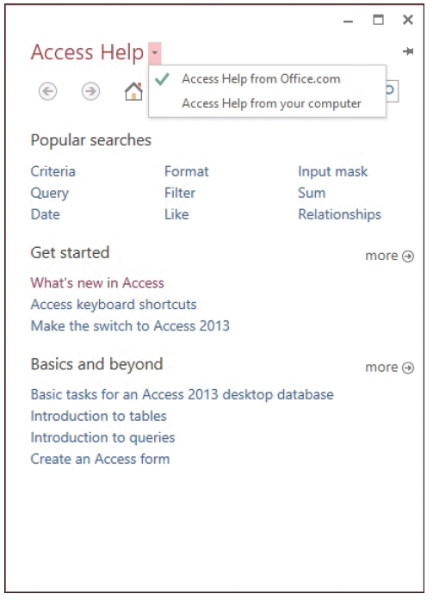
Step by Step: Use the Help Button and Change Help Location Menu
Click the Change Help Location button. A menu appears, as shown at right.

Slide 29
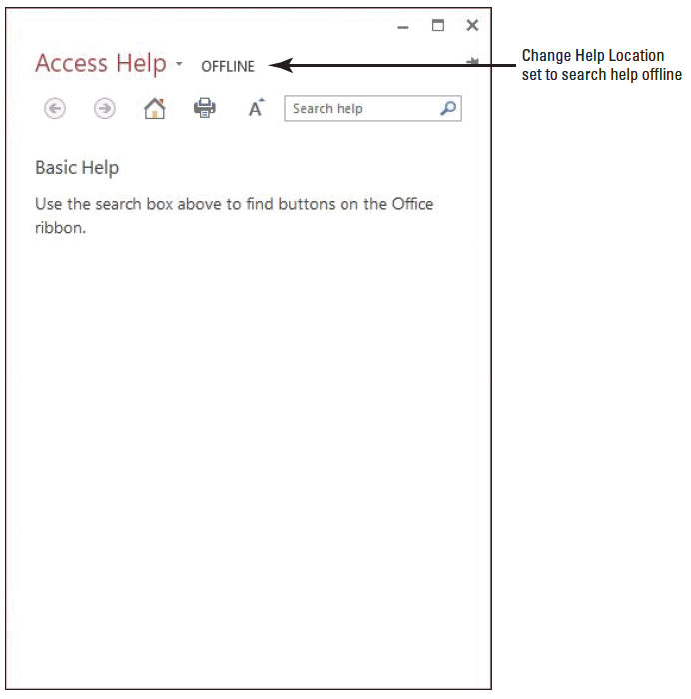
Step by Step: Use the Help Button and Change Help Location Menu
Click Access Help from your computer. Basic Help appears, as shown at right.
In the Search help text box, key font and then click the Search button. A list of possible locations on the ribbon where fonts can be manipulated appears.
In the search results that appear, click the Font is under Home/Text Formatting link. Help on this topic appears.

Slide 30

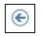

Step by Step: Use the Help Button and Change Help Location Menu
Click the Keep Help on Top button. The Access Help dialog box is now pinned to the front of the window so it is always on top and easily referred and not hidden even if another screen element is clicked.
Click the Back button. The search results for font appear again.
Click the Home button. The home page of Access Help appears.
Click the Change Help Location button.
Click Access Help from Office.com to reset the help location.
Click the Close button to close Access Help.
STOP. CLOSE the database.

Slide 31
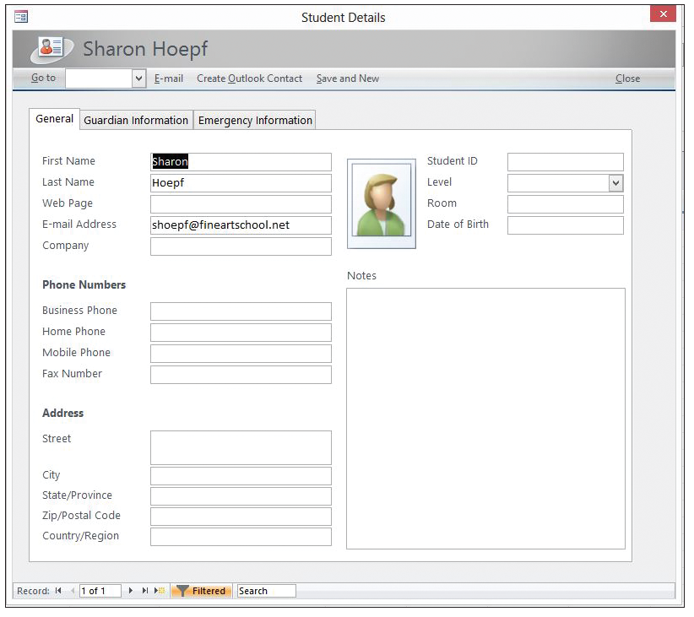
Step by Step: Define Table Fields
OPEN the Student Data database from the data files for this lesson.
On the Student List form, click the ID for record 5 to display the Student Details dialog box for Sharon Hoepf, as shown at right.
Click the Guardian Infor- mation tab and then the Emergency Information tab. Each field on each tab is an example of the type of information that could be contained in a database table.
Click Close to close the Student Details dialog box.
PAUSE. LEAVE the database open to use in the next exercise.
Notes:
Cross-Reference: You learn more about defining and modifying a primary key in Lesson 3.

Slide 32
Step by Step: Review and Modify Data Types for Fields
USE the database you used in the previous exercise.
Close the Student List form.
In the Navigation Pane, in the Students group, double-click the Students table to open it.
Click the Date of Birth field header.
On the Ribbon, click the Fields tab. Notice in the Formatting group that the Data Type is Date/Time.

Slide 33
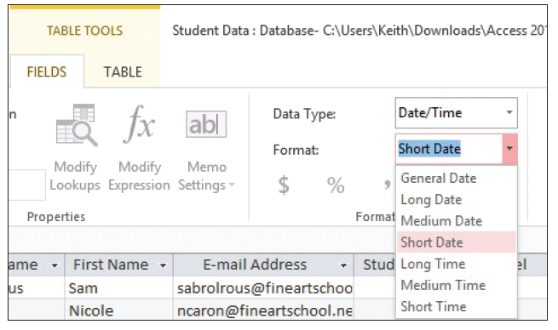
Step by Step: Review and Modify Data Types for Fields
In the Format box, click the down arrow to display the menu of formatting options for that type, as shown at right.
Click the Last Name header. Notice that the Data Type is Short Text and that no formatting options are available for that data type.

Slide 34
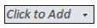
Step by Step: Review and Modify Data Types for Fields
Scroll to the right and click the Address header.
In the Data Type box, click the down arrow and then click Short Text to change the data type.
Scroll to the far right and click the Click to Add column header. In the Data Type drop-down list that appears, click Yes/No. Notice the name of the column header, Field1, is highlighted.
Rename the field by keying Additional Contact Info on File?
Notes:
Take Note: Be aware that changing a data type might cut off some or all of the data in a field;in some cases, it might remove the data entirely.

Slide 35
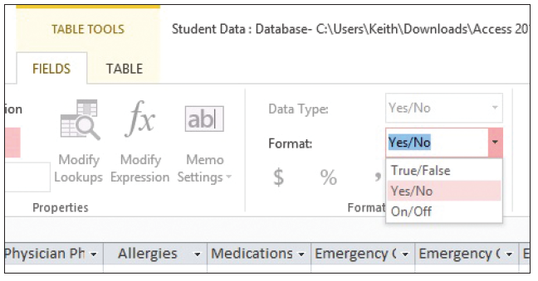
Step by Step: Review and Modify Data Types for Fields
On the Ribbon, in the Formatting group, click the down arrow in the Format box to display the menu of formatting options for the Yes/No data type, as shown above.
Click outside the menu to close it.
PAUSE. LEAVE the database open to use in the next exercise.

Slide 36
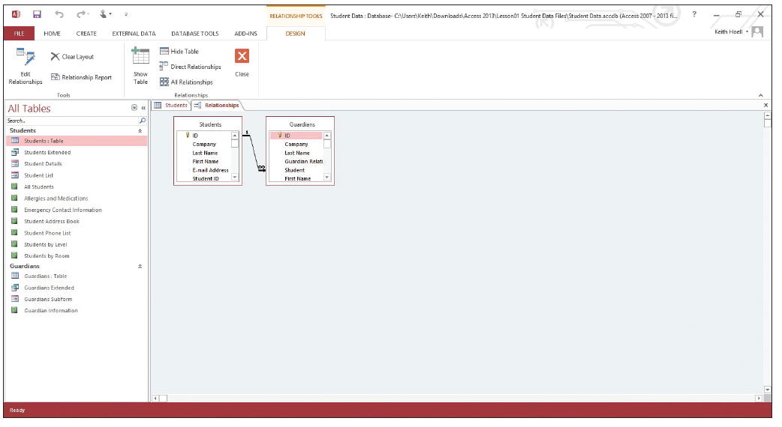
Step by Step: Define Database Tables
USE the database you used in the previous exercise.
On the DATABASE TOOLS tab, in the Relationships section, click Relationships to display a visual representation of the relationship between the Students and Guardians tables, as shown below.

Slide 37
Step by Step: Define Database Tables
Close the Relationships tab.
Close the Students tab.
STOP. CLOSE the database.
Notes:
Cross Reference: You learn more about table relationships in Lesson 3.

Slide 38
Skill Summary

